Slide 1

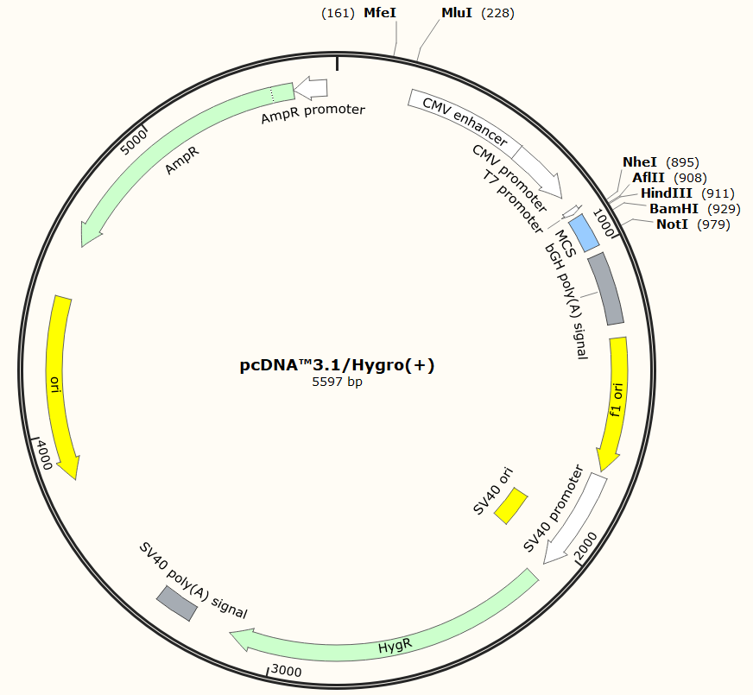
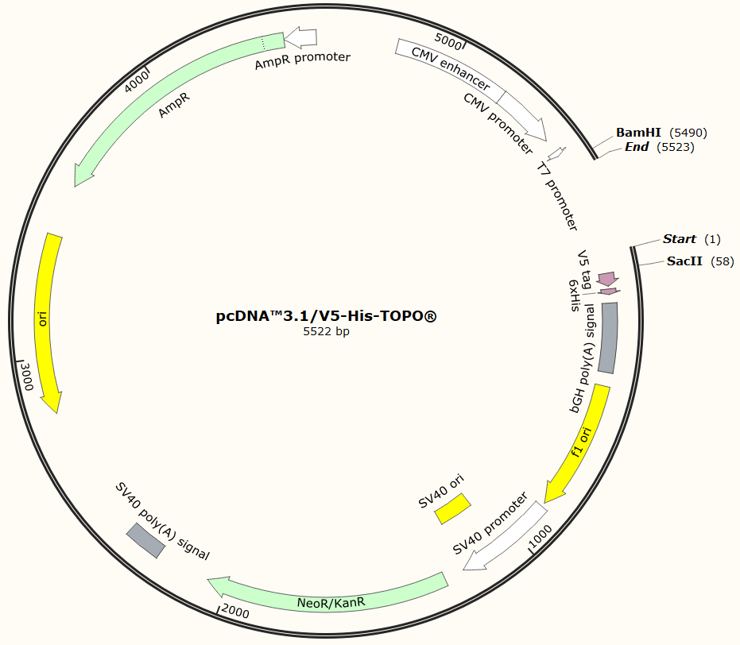
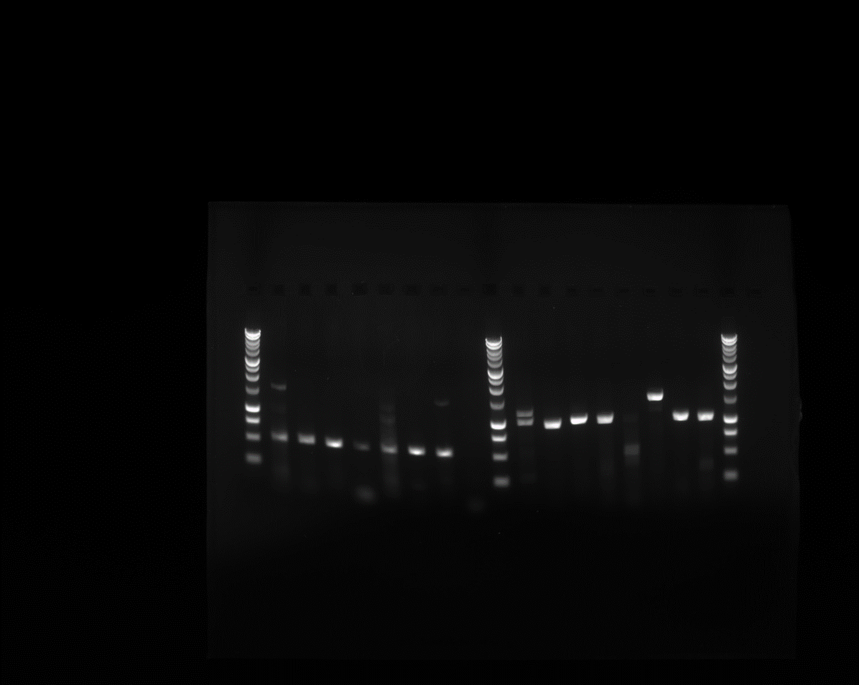
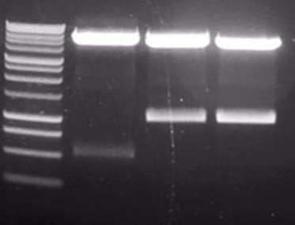
School of Biosciences
Identification, Generation and Validation of Endogenous Symbiodinium microadriaticum Promoters and Promoter Regions to Drive Exogenous Gene Expression
Romain Landolfini (rtyl2@kent.ac.uk) / Supervised by James Budge and Mark Smales / Special thanks to Dr. Manuel Aranda & Dr. Rachel Levine
1. introduction
Coral reefs are important ecosystem for wildlife and local populations. However, they are suffering greatly due to coral bleaching, a disease triggered by high sea surface temperature which results in the destruction or expulsion of the endosymbiotic microalgae from the coral cells, leaving the coral without its major source of energy.
Current ecological methods are not sufficiently mitigating these effects. Efforts have gone into trying to genetically engineer the microalgae known as Symbiodinium in order to engineer a bleaching-resistant phenotype. Although these studies have improved on the genomic data on the genus, a reproducible strategy for engineering Symbiodinium has yet to be achieved.
Here we aim to identify and isolate potential promoter regions in Symbiodinium microadriaticum upstream of genes encoding highly expressed mRNAs and transfer them into a pcDNATM3.1/Hygro⁽⁺⁾ vector expressing mCherry and a V5-his tag for later transfection into Symbiodinium microadriaticum cells.
Aims of the project:
Identify potential promoter regions of highly expressed nuclear genes in the Symbiodinium microadriaticum genome.
Isolate 1 kb and 500 bp sequences of these regions for ligation into the pcDNATM3.1/Hygro⁽⁺⁾ vector.
Generate a pcDNATM3.1/Hygro⁽⁺⁾ vector containing potential promoter regions and determine if these can drive transcription of a reporter gene, mCherry.
Table 1. Highly expressed nuclear genes used for endogenous promoter identification and isolation: The sequences for these genes were aligned with the Symbiodinium macroadriaticum (strain CCMP2467) genome. 1kb and 500bp sequences upstream of the start codon for each gene were selected to amplify by PCR and insertion into a custom construct. These sequences were isolated from genomic DNA from Symbiodinium macroadriaticum cells. Primers were designed for an annealing temperature of 63°C and to be cleaved by MluI/MfeI and NheI. These genes were selected based on transcriptomic studies of Symbiodinium microadriaticum showing they’re high expression levels.
Gene name | Protein product | molecular function | UniProtKB code
N/A (pcb) | Peridinin-chlorophyll a-binding protein | Light-harvesting polypeptide | P51874
AK812_SmicGene41855 | Caroteno-chlorophyll a-c-binding protein | Photosynthesis | A0A1Q9C529
HCc2 | Major basic nuclear protein 2 | DNA binding | A0A1Q9D940
AK812_SmicGene5572 | Hypothetical protein (dinoflagellate viral nucleoprotein) | Uncharacterised | A0A1Q9ET57
GapC3 | Glyceraldehyde-3-phosphate dehydrogenase | Oxidoreductase | Q76EI0
slc43a2 | Large neutral amino acids transporter small subunit 4 | Amino acid transport | A0A1Q9D5K2
Abca4 | Retinal-specific ATP-binding cassette transporter | ATP-binding | A0A1Q9DUI6
2. Isolating promoter regions
3. Cloning of Sequences into pcdna3.1
The potential promoter regions were amplified by PCR using primers that included recognition sites for the restriction enzymes MluI or MfeI (forward primers) and NheI (reverse primers). For each gene (Table 1), 1kb and 500bp sequences upstream of a start codon were selected for isolation. The PCR products were run on an agarose gel for testing (Fig 1). Symbiodinium microadriaticum DNA was supplied by the Symbiomics Lab in KAUST.
The acceptor plasmid DNA was generated in E.coli to produce the pcDNATM3.1/Hygro⁽⁺⁾ (Fig 2) and pcDNATM 3.1/V5-His_TOPO® (Fig 3) vector. The mCherry gene was amplified by PCR using primers with sequences for the BamHI and SacII restriction enzymes for cloning. These same restriction enzymes were used on the pcDNATM 3.1/V5-His_TOPO® vector.
10,000 bp -
1 2 3 4 5 6 7 8 9 10 11 12 13 14 15 16
3000 bp ---
2000 bp ---
1500 bp ---
1000 bp --
750 bp --
500 bp --
250 bp --
Fig 2: pcDNATM3.1/Hygro⁽⁺⁾ vector and used restriction sites
Fig 3: pcDNATM 3.1/V5-His_TOPO® vector and used restriction sites
Fig 1: Agarose gel showing PCR products upstream of gene regions: [1]. 500bp, slc43a2 region A. [2]. 500bp, slc43a2 region B. [3]. 500bp, slc43a2 region C. [4]. 500bp, Abca4. [5]. 500bp, pcb. [6]. 500bp, AK812_SmicGene41855. [7]. 500bp, HCc2. [8]. 500bp, AK812_SmicGene5572. [9]. 1kb, slc43a2 region A. [10]. 1kb, slc43a2 region B. [11]. 1kb, slc43a2 region C. [12]. 1kb, Abca4. [13]. 1kb, pcb. [14]. 1.4kb, AK812_SmicGene41855. [15]. 1kb, HCc2. [16]. 1kb, AK812_SmicGene5572.
The promoter sequences were digested and ligated into the pcDNATM3.1/Hygro⁽⁺⁾ using MluI and NheI (Fig 4). The mCherry and V5-his tag were amplified by primers enabling them to be digested by NheI (forward) and NotI (reverse) and were ligated into the pcDNATM3.1/Hygro⁽⁺⁾ expressing the promoter sequences.
10,000 bp --
1 2 3
Fig 4: Agarose gel showing successful ligation of promoter sequences and pcDNATM3.1/Hygro(+):
1. the pcDNATM3.1/Hygro⁽⁺⁾ and 500bp upstream of slc43a2 region A. 2. the pcDNATM3.1/Hygro⁽⁺⁾ and 1kb upstream of AK812_SmicGene41855 3. the pcDNATM3.1/Hygro⁽⁺⁾ and 1kb upstream of AK812_SmicGene5572. These were tested using MluI and HindIII.
All but the 500bp sequence upstream of slc43a2 and the 1kb sequence upstream of pcb were successfully amplified. So far, sequences 500bp upstream of slc43a2 region A, 1kb upstream of AK812_SmicGene41855 and 1kb upstream of AK812_SmicGene5572 have been cloned into the pcDNATM3.1/Hygro⁽⁺⁾ in place of the existing CMV promoter.
3000 bp --
1500 bp --
1000 bp --
750 bp --
500 bp --
250 bp --
4. Summary
5. Future work
We have identified and isolated sequences upstream of highly expressed nuclear Symbiodinium microadriaticum genes.
Custom pcDNATM3.1/Hygro⁽⁺⁾ vectors expressing 3 separate endogenous Symbiodinium microadriaticum potential promoter sequences, mCherry and a V5-His tag have been generated.
Transform Symbiodinium microadriaticum cells with the custom expression construct and test expression of mCherry to confirm whether the isolated sequences can act as promoters to drive exogenous gene expression.
Ligate Symbiodinium genes for thermal tolerance into the vector and test its ability of conveying resistance to coral from bleaching.
6. References
[1] Chen, J.E., Cui, G. and Lastra, M.A., 2017. The genetic intractability of Symbiodinium microadriaticum to standard algal transformation methods. bioRxiv, p.140616.; [2] Levin, R.A., Voolstra, C.R., Agrawal, S., Steinberg, P.D., Suggett, D.J. and van Oppen, M.J., 2017. Engineering strategies to decode and enhance the genomes of coral symbionts. Frontiers in microbiology, 8, p.1220.; [3] Berkelmans, R. and Van Oppen, M.J., 2006. The role of zooxanthellae in the thermal tolerance of corals: a ‘nugget of hope’for coral reefs in an era of climate change. Proceedings of the Royal Society of London B: Biological Sciences, 273(1599), pp.2305-2312.; [4] Levin, R.A., Beltran, V.H., Hill, R., Kjelleberg, S., McDougald, D., Steinberg, P.D. and van Oppen, M.J., 2016. Sex, scavengers, and chaperones: transcriptome secrets of divergent Symbiodinium thermal tolerances. Molecular biology and evolution, 33(9), pp.2201-2215.

